Slide 1
Git for SVN brukere
From centralized to distributed SCM
in two hours
Kazi Abdullah Saikat, Tech-1, Dev-3, Oslo

Slide 2
Tools
Git clients,
- gitk
- gitg
- git : command line
- Intellij has a good git integration, probably Eclipse and Visual Studio too ;-)
Source code hosting solutions,
- github : free for open-source projects. Private projects need a subscription
- bitbucket : free for all projects. Max 5 collaborators for free.
- gitolite : create your own central git repository

Slide 3
Quick example
Command/Scm | Git | SVN
Checkout | git clone url | svn checkout url
Update | git pull | svn update
Help | git help | svn help

Slide 4
Git concepts, differences with SVN
 | Git | SVN
Repository | Each copy of the project tree (a working copy) carries its own repository along with it’s own history (under a local directory .git under the project tree root) | Each project there is a single repository at some detached central place where all the history is and which you checkout and commit into

Slide 5
Git concepts, differences with SVN...
 | Git | SVN
URL | The URL is just the location of the repository, and the content at the url contains branches and tags. The default branch is master. | URL identifies the location of the repository and the path inside the repository. So branches are a part of the repository. I.e. trunk/, branches/, tags/ etc.

Slide 6
Git concepts, differences with SVN...
 | Git | SVN
Revisions | Git identifies revisions with SHA1 ids. Example: 2a496429b43c5b96270773ac5075e5959af8c508 | Revisions with ids of decimal numbers, increases with every commit.
Git commits can be thought of as “patch” files containing only “insertions” and “deletions”.

Slide 7
Git concepts, differences with SVN...
 | Git | SVN
Commits | - Has an author and a committer field - Commits can be applied on a project using “patches” coming through an email. In this case, an author and a committer are two different persons. | Revisions with ids of decimal numbers, increases with every commit.
Git config | git config --global user.name "Cool Dude" git config --global user.email cooldude@example.com
Git color | git config --global color.diff auto git config --global color.status auto git config --global color.branch auto

Slide 8
Git commands and comparison
Starting with a repository
Git | SVN
$ git init $ git add . $ git commit [-a] $ git status | $ svnadmin create repo $ svn import file://repo $ svn status

Slide 9
Git commands and comparison...
Add, remove and rename files
Git | SVN
$ git add file $ git rm file $ git mv src dest $ git log | $ svn add file $ svn rm file $ svn mv src dest $ svn log

Slide 10
Where is my origin? Where am I committing?
$ git clone git@github.com:saikat047/Git-for-SVN-users.git
Running the command above will do the following,
- create a local directory named Git-for-SVN-users
- copy all the content including branch, tag and other informations
- create a synonym origin that refers to the remote url git@github.com:saikat047/Git-for-SVN-users.git
- all commits in git are made to the local repository
- local changes are pushed to the remote repository when we run, $ git push origin branch-name
I.e. if we want the changes made to the master branch in the local repo to be send to the remote repository, we do the following: $ git push origin master

Slide 11
Updating your local repository
$ git pull origin
This will retrieve the repository and merge the remote branches with your local branches.
In theory, the command above does two things,
$ git fetch origin
$ git merge origin/master
If the local branch (i.e. master) does not already have all the changes found in the remote repository, a “merge” commit occurs (undesirable). Imagine running 5 developers running “git pull” 3-4 times a day. That will result in more than 10 “merge” commits that does not add any value to the project source code history.

Slide 12
Updating your local repository...
$ git fetch origin
This will only retrieve the latest status from the origin repository. No changes will be made to your local repo.
$ git rebase origin/branch-name
This operation does the following steps in order,
- Record all local changes (each change/commit can be thought of as single patch file)
- Reset your local branch with the exact content from the remote branch “origin/branch-name”
- Apply all your previously recorded local changes on top of the branch “reset” in the previous step
The two operations above can be performed with a single command as follows,
$ git pull --rebase

Slide 13
Git undo / reset
- Git only understands content (not file) when it generates commit id
- Git repo can be imagined to be a archive of archives (where each branch is an inner archive)
- Each commit hash is a SHA-1 hash of the full content in current branch
- To reset changes not committed yet,
$ git reset --hard
- To fully reset a local branch with a remote branch,
$ git reset --hard origin/master
Warning: All local changes will be gone.

Slide 14
Where is my head?
- HEAD is just a synonym of the top revision of the current branch (commit hash id)
Example: git rebase -i HEAD^2
- When we refer to a branch, we are always referring to the HEAD revision of the branch
Example: git reset --hard HEAD
$ git reset --hard is the same as running, $ git reset --hard HEAD
$ git reset --hard is the same as running, $ git reset --hard a10206 where “a10206” is the latest commit on the local branch.
Git reset commands result in console output,
HEAD is now at commit-id commit-message

Slide 15
Git branching and merging
- To create a new branch, git checkout -b new-branch-name
- To send the locally created branch to the remote repository, git push origin new-branch-name
- To merge a branch PB-100 to master,
ensure that you are already on master. If not, git checkout master
Now to merge the branch: git merge PB-100
Note that after the merge above, only your local master is updated with the changes from PB-100. You have to run, $ git push origin master to updated the remote branch.

Slide 16
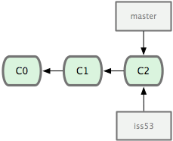
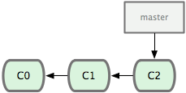
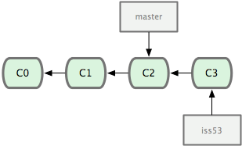
Git merge visualised
git checkout -b iss53
git add readme
git commit -m “Check-in readme”
Change list C3 created
iss53 HEAD updated to point to C3.

Slide 17
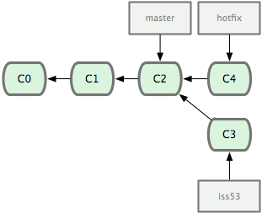
Git merge visualised...
git checkout master
git checkout -b hotfix
(Creates hotfix branch from master)
git add hotfix.java
git commit -m “add hotfix patch”
Branch hotfix created.
Change-list C4 committed.
Branch hotfix HEAD updated to C4.

Slide 18
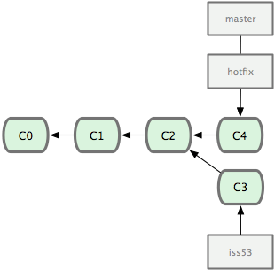
Git merge visualised...
git checkout master
git merge hotfix
A fast-forward merge.
Since hotfix has everything in master, master is simply updated to point to HEAD of hotfix

Slide 19
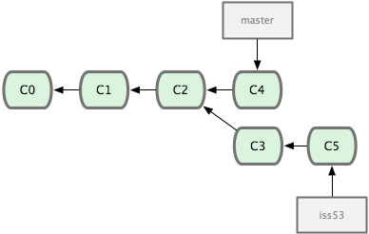
Git merge visualised...
git checkout iss53
git add iss53.java
git commit -m “add iss53 branch code”
Change list C5 created
iss53 HEAD updated to C5

Slide 20
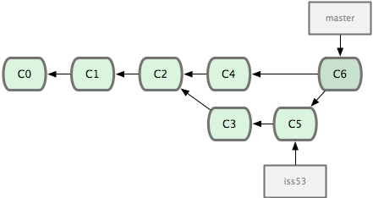
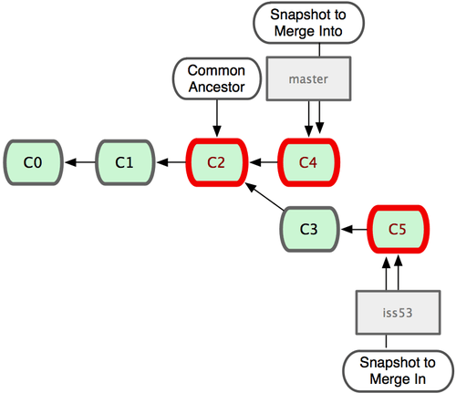
Git merge visualised...
A single merge commit C6 has taken place representing C3, C5 and any conflicts resolved.
git checkout master
git merge iss53

Slide 21
Git rebasing
- rebase is the preferred way of merging branches
- rebase rewrites history
- rebase can be used to change commit-messages
- rebase can be used to squash two or more commits together
- rebase can be used to completely remove commits from the history
Syntax,
$ git rebase origin/master
$ git rebase -i origin/master
# -i is interactive mode where you can rewrite commit messages, squash commits together or completely discard a commit
$ git rebase any-branch

Slide 22
Git rebasing...
 | Master | PB-100
Before rebase | 1 - 2 - 3 - 4 - 5 | 1 - 2 - 3 - 6
Imagine two branches master and PB-100.
While on PB-100, if we run: $ git rebase master
PB-100’s history will be rewritten to : 1 - 2 - 3 - 4 - 5 - 6”
What happens is as follows,
 | Master | PB-100
Reset while rebasing | 1 - 2 - 3 - 4 - 5 | 1 - 2 - 3 - 4 - 5
- Git finds the latest common parent commit 3
- Records the commit 6 as an own commit on PB-100
- Resets PB-100 to history: 1 - 2 - 3 - 4 - 5 (exactly as master)
 | Master | PB-100
After rebase | 1 - 2 - 3 - 4 - 5 | 1 - 2 - 3 - 4 - 5 - 6”
- Applies the recorded commit 6 on top of PB-100
- As a result, the SHA-1 key of commit 6 is changed to 6”
- Remember that git commit id is generated on the total content of a branch in the repository.
Since content prior to commit 6 on PB-100 before rebase was “1 - 2 - 3”, but after rebasing became “1 - 2 - 3 - 4 - 5”, applying changes in commit 6 generates a SHA-1 key on “1 - 2 - 3 - 4 - 5 - 6” and NOT “1 - 2 - 3 - 6”.

Slide 23
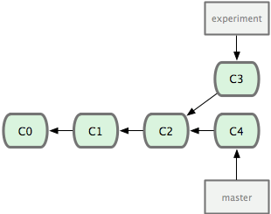
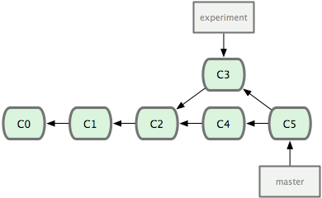
Git rebasing visualised
Created merge commit C5
Updated master HEAD to C5
git checkout master
git merge experiment

Slide 24
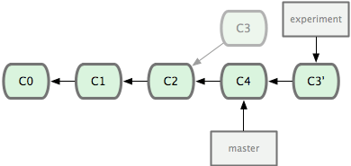
Git rebasing visualised...
Rebases commit C3 on top of master (C4)
C3 gets new commit id C3’
experiment HEAD is updated to C3’
git checkout experiment
git rebase master

Slide 25
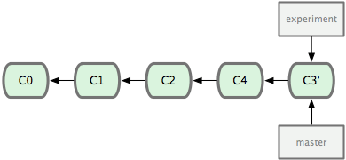
Git rebasing visualised...
git checkout master
git merge experiment
experiment already had all changes from master
master HEAD is simply updated to C3’

Slide 26
Git commit accept / reject
- Git only accepts your content if the HEAD revision of the remote branch exists in the history of your local branch
- Git will simply reject your push otherwise assuming your local copy is outdated
- Usual workflow is to simply rebase on top of the remote branch before running “git push”
- This will simply update your local branch with all the content of the remote branch and move your local changes on top it
- As a result, running the next “git push” will send local branch content that contains the HEAD revision of the remote branch
- Git will happily apply only the newer commits of your local branch on top of the remote branch to update the remote branch. As an example, if “git push origin PB-100” fails, you can run
$ git fetch origin
$ git rebase origin/PB-100
$ git push origin PB-100

Slide 27
Git commit accept / reject...
$ git push origin master
Since commit C3 exists on master’s history, origin/master happily accepts all incoming changes from master
 | Master | origin/master
Before push | C1 - C2 - C3 - C4 - C5 | C1 - C2 - C3
 | Master | origin/master
Push success | C1 - C2 - C3 - C4 - C5 | C1 - C2 - C3 - C4 - C5

Slide 28
Git commit accept / reject...
$ git push origin master
Since HEAD of origin/master (C6) does not exist in local master’s history, origin/master will reject the push request
 | Master | origin/master
Before push | C1 - C2 - C3 - C4 - C5 | C1 - C2 - C3 - C6
$ git rebase origin/master
 | Master | origin/master
After rebase | C1 - C2 - C3 - C6 - C4” - C5” | C1 - C2 - C3 - C6
$ git push origin master
 | Master | origin/master
After push | C1 - C2 - C3 - C6 - C4” - C5” | C1 - C2 - C3 - C6 - C4” - C5”
After rebase operation, local master now have C6. Therefore, origin/master will accept the next push.

Slide 29
Git rebase (caution)
- Never rewrite commit messages of already committed and pushed changes on origin/master
- Squashing local changes together before they are pushed to remote repository is a good thing
- Do not over do squashing. Commits should hold together logical changes
- When working a separate branch, consider rebasing on master branch as often as possible to resolve conflicts early
Since rebase changes history, remote repository may reject your attempt to push a local branch since the HEAD revision of remote branch no longer exists in your local branch history.

Slide 30
Git rebase (caution) ...
If you are absolutely certain that your branch holds the right content, you may “force push” your local branch: $ git push origin branch-name -f (this must never be done on master)
- As an example, if your colleague has “force pushed” his changes on branch PB-100, then everyone working on PB-100 needs to “fully reset” their local PB-100 branch
- Use “git stash” to save the day

Slide 31
Git stash
Git stash moves all your local “uncommitted” changes into a change-list and resets your local branch to it’s local HEAD revision.
If you are working on branch PB-100 and someone has “force pushed” on remote PB-100 branch, you may try the following,
$ git stash # this will save all your local uncommitted changes
$ git fetch origin # get the latest content from origin
$ git reset --hard origin/PB-100
$ git stash pop # you may also use $ git stash apply
To have a look at local stashes, you can run : $ git stash list
It’s possible to apply any “stashed change-list” and not just the top of the stack.

Slide 32
Git rebase (caution) ...
- Therefore, you should never “force push” on the master branch
- When you “force push” a branch, always talk to your colleagues to verify that others have already committed and pushed all their changes on that branch

Slide 33
Git merging and fast-forwarding
- git merge operation resolves conflicts where possible
- If “git merge” finds no conflicts and only changes in the merging branch are missing from the master, git will simply update master HEAD to the newest commit on your branch. This is called “fast-forwarding”
- To be able to perform “fast-forward”, your branch needs to be “rebased” on the latest commit of the master branch so that the branch includes all changes available on master

Slide 34
Git “feature branch”
- A branch created solely to create a feature
- Once the feature is done, it’s merged on to master and the branch is deleted
- A necessary evil (muhahahah… as the sound fades slowly in the background)
- Always evaluate if you “really” need a feature branch
- Rebase on the main (master) branch at-least once a day to stay in sync and resolve conflicts early
- Before merging a feature branch, ensure that everything on the feature branch is rebased on the master and “pushed” to the origin feature branch
- Before merging a feature branch to a local branch, ensure that your local branch is in sync with origin
- When you merge your feature branch to f.eks. master, ensure that $ git merge feature-branch results in a “fast-forwarded” status
- Once a merge is complete with “fast-forward” status, push to origin asap

Slide 35
Git tagging
- You can create a tag using : $ git tag tag-name
- You have to pass special parameter to push tags to the remote end : $ git push --tags
- A tag in Git is just a convenient name of a commit hash id
- You can reset any branch to a tag using : $ git reset --hard tag-name

Slide 36
Workshop: Initialize a local git repo and play with it
Example repository available at: https://github.com/saikat047/gittut.git
Clone repository using,
$ git clone https://github.com/saikat047/gittut.git
Look at nice command-line graph,
$ git log --graph --all --abbrev-commit --decorate
Or use $ gitk or $ gitg

Slide 37
Workshop: Initialize a local git repo and play with it...
- Attempt a merge of “patchwork” branch on to “master”
Use gitg, gitk or $ git log --graph --all --abbrev-commit --decorate
to have a look at how the branch graph looks like.
Remove all your local changes (the merge operation you just did). Hint: git reset ?

Slide 38
Workshop: Initialize a local git repo and play with it...
- Attempt a fast-forward merge of “patchwork” branch on to “master”
First checkout “patchwork” branch
Rebase it on top of master
Look at the branch graph to verify that “patchwork” now includes all changes from master
Checkout “master”
Merge “patchwork” branch
Verify that the merge operation was a “fast-forward” operation

Slide 39
Git Q & A
- What is the difference between the two commands,
$ git reset --hard master
$ git reset --hard origin/master
- What is the difference between
$ git merge
$ git rebase
- What is a “fast-forward” merge?
- When can “git merge” and “git rebase” change the commit id of already committed changes?

Slide 40
Thank you
- http://git.or.cz/course/svn.html
- http://git-scm.com/book/en/Git-Branching-Basic-Branching-and-Merging

